Slide 1

Huawei HCCDA-AI certification
Instructor : Fawad Bahadur

Slide 2


Basic Data Formats – CSV & JSON and Their Manipulation
Dated: 20 July 2025
Instructor : Fawad Bahadur

Slide 3
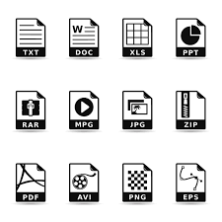
Introduction to Data Formats
What are data formats?
Why we need them: data storage, sharing, exchange
Structured vs unstructured formats
Focus: CSV and JSON

Slide 4


What is CSV?
CSV = Comma-Separated Values
Used to represent tabular data
Each line = one record (row)
Columns separated by commas
Commonly used in Excel, databases, Python, ML
Example:
Name,Age,Country
Ali,21,Pakistan
John,25,USA

Slide 5

CSV: Characteristics
Plain text (easily readable)
Lightweight, fast
Can be opened with:
Excel
Text editor
Python (pandas, csv module)

Slide 6
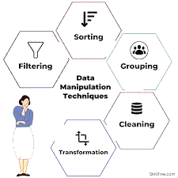

CSV Manipulation in Excel
Open .csv file in Excel → rows/columns auto-organized
Can:
Sort & filter
Add formulas
Save as .xlsx or .csv again

Slide 7

CSV Manipulation in Python
import pandas as pd
# Read
df = pd.read_csv("data.csv")
# View
print(df.head())
# Filter
young = df[df["Age"] < 25]
# Save
young.to_csv("young_people.csv", index=False)

Slide 8

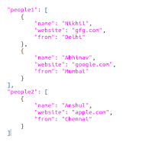
What is JSON?
JSON = JavaScript Object Notation
Used for structured data exchange
Format = key-value pairs
Supports:
Lists (arrays)
Nested objects
Used in APIs, config files, web data
Example:
{
"name": "Ali",
"age": 21,
"skills": ["Python", "ML"]
}

Slide 9

JSON: Characteristics
Human-readable
More flexible and hierarchical than CSV
Often used in:
Web development
REST APIs
MongoDB

Slide 10
JSON Manipulation in Python
import json
# Load from string or file
with open("data.json") as f:
data = json.load(f)
# Access
print(data["name"])
# Modify
data["age"] = 22
# Save
with open("updated.json", "w") as f:
json.dump(data, f, indent=4)

Slide 11
CSV vs JSON Comparison
Feature | CSV | JSON
Format | Tabular (rows/cols) | Hierarchical (tree)
Readability | High | High
Structure | Flat | Nested
Use Case | Spreadsheets, ML | APIs, configs, web data
Tools | Excel, pandas | Python json, APIs

Slide 12
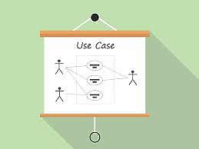

Real-World Use Cases
📌 CSV:
Datasets for Machine Learning (e.g., Titanic dataset)
Student records, attendance, sales logs
Bank statements
📌 JSON:
API response (e.g., weather, user info)
App configuration
Chatbot logic, mobile app data

Slide 13

Best Practices
Always validate data format before parsing
Use proper encoding (utf-8)
Handle missing values
Pretty print JSON (indent=4)
Avoid mixing data types in columns (CSV)

Slide 14
Huawei Cloud EI: Empowering AI Innovation Globally
Vision, NLP, Speech, OCR, ModelArts, HiLens
Dated: 20 July 2025
Instructor : Fawad Bahadur

Slide 15
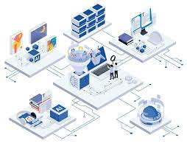
Huawei Cloud Enterprise Intelligence (EI) Portfolio
Vision:
Object detection, image classification, facial recognition
Natural Language Processing:
Text classification, sentiment analysis, machine translation
Speech:
Voice recognition, speech synthesis, real-time transcription
OCR:
High-accuracy document and invoice recognition

Slide 16

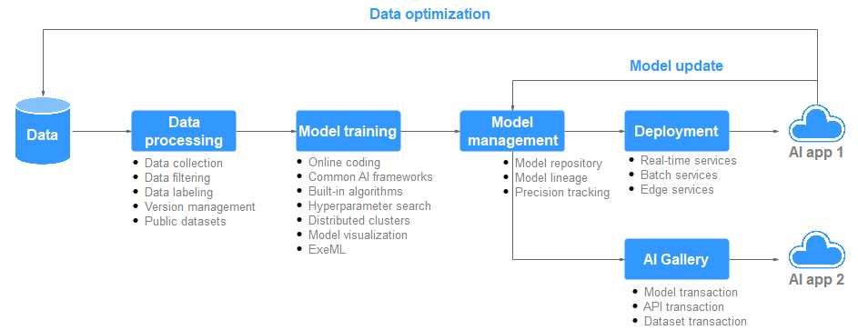
ModelArts: End-to-End AI Lifecycle Management
Data labeling, training, tuning, deployment in one platform
AutoML support for beginners and experts
Supports TensorFlow, PyTorch, MindSpore

Slide 17

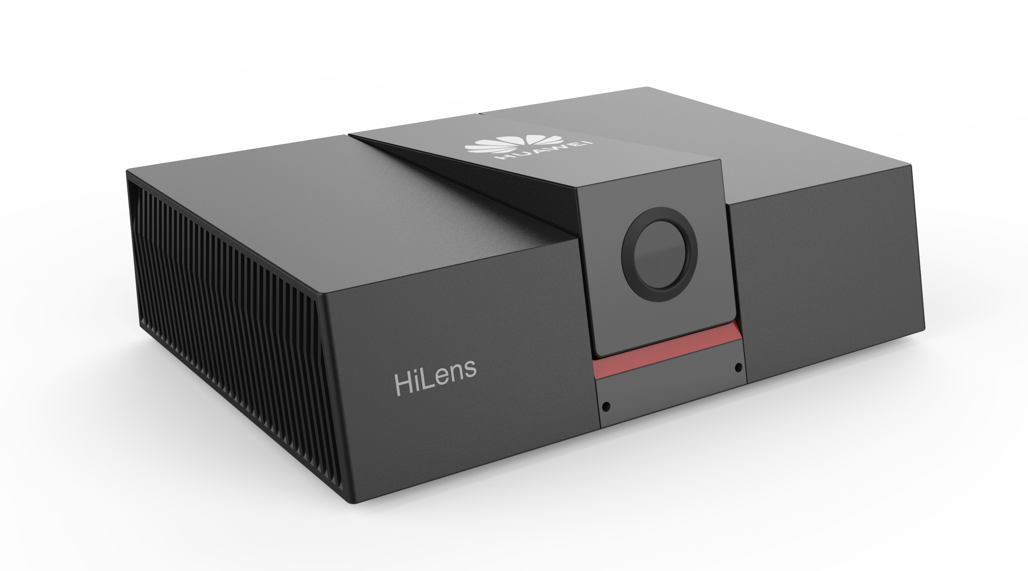
HiLens – Edge AI with Cloud Intelligence
Built-in AI models for face, object, and behavior recognition
Works seamlessly with ModelArts and the cloud
Use cases: Smart surveillance, retail analytics

Slide 18



Huawei’s Global AI Initiatives
Ascend AI processors deployed globally
Open-source MindSpore framework
AI education with universities (e.g., Seeds for the Future)
Collaborations in healthcare, transportation, and smart cities

Slide 19
AI Use Cases Powered by Huawei
Use Case | Huawei Capability
Smart Healthcare | NLP + OCR + Speech AI
Intelligent Finance | OCR + NLP + ModelArts
Retail Video Analytics | Vision AI + HiLens
Automated Call Centers | Speech Recognition + NLP
Smart City Surveillance | Vision AI + HiLens

Slide 20
Cloud-Based Tools for AI/ML
.
Dated: 20 July 2025
Instructor : Fawad Bahadur

Slide 21


Google Colab (Collaboratory)
Free cloud-based Jupyter Notebook environment.
Backed by Google Drive – auto-save & easy sharing.
Provides free CPU, GPU, and TPU access.
Ideal for beginners, students, and prototyping.
Integrated with Python libraries: TensorFlow, PyTorch, OpenCV, etc.
Easy integration with Google services and GitHub.
Example Use Cases:
Training ML models quickly
Writing and running notebooks collaboratively

Slide 22

AWS SageMaker
Fully managed machine learning service by Amazon Web Services.
Enables building, training, and deploying ML models at scale.
Offers built-in algorithms, AutoML, and pre-built Jupyter Notebooks.
Supports Docker containers and custom ML workflows.
Features:
Studio IDE for end-to-end ML
Model monitoring & deployment (A/B testing, multi-model endpoints)
Integration with S3, EC2, Lambda, etc.

Slide 23
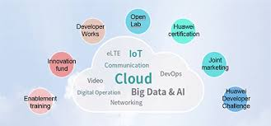
Huawei Cloud ModelArts
AI development platform for model training, management, and deployment.
Provides a visual drag-and-drop interface for model development.
Offers GPU and Ascend AI processor instances.
Supports AutoML, data labeling tools, and distributed training.
Strong in image classification, object detection, and NLP tasks.
Seamless integration with Huawei's ecosystem.

Slide 24
Calling REST APIs from a Script
.
Dated: 20 July 2025
Instructor : Fawad Bahadur

Slide 25
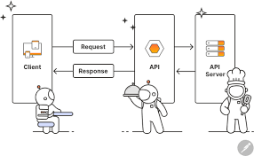
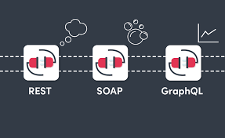
What is an API?
API = Application Programming Interface
Allows two software systems to communicate
Acts as a bridge between your app/script and a web service
Types of APIs:
REST (most common)
SOAP
GraphQL

Slide 26

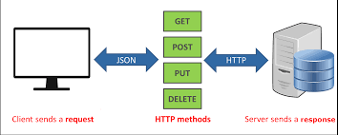
What is a REST API?
REST = Representational State Transfer
Web-based API that uses HTTP requests
Works with resources (like users, posts, products)
Uses standard HTTP methods:
GET – retrieve data
POST – send new data
PUT/PATCH – update existing data
DELETE – remove data

Slide 27


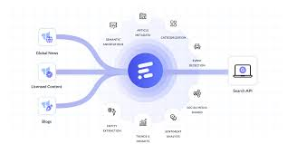
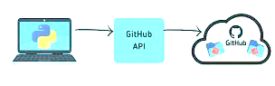
Real-Life Examples of REST APIs
Weather API: get current weather
Twitter API: fetch tweets
GitHub API: get repo details
News API: get latest headlines

Slide 28



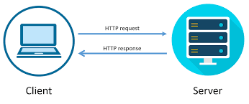
Tools You Need
Programming language (e.g., Python)
Module for HTTP requests (e.g., requests)
API endpoint URL
API key (for authentication if needed)

Slide 29
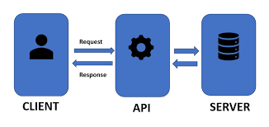
Basic Python Script to Call an API (GET)
import requests
url = "https://api.github.com/users/octocat"
response = requests.get(url)
print(response.status_code)
print(response.json())
Explanation:
requests.get() makes the GET call
.json() converts response to Python dict

Slide 30
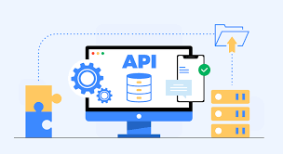
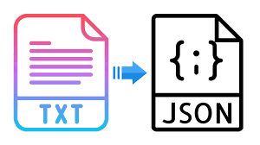

Understanding the Response
.status_code:
HTTP status (200 = OK, 404 = Not Found)
.json():
Converts response to a dictionary
.text:
Raw response as string

Slide 31
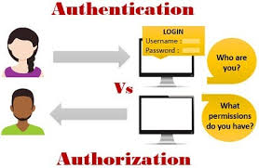

Common Status Codes
headers = {"Authorization": "Bearer <token>"}
response = requests.get("https://api.example.com/user", headers=headers)
Needed for APIs that require authentication
Code | Meaning
200 | OK
201 | Created
400 | Bad Request
401 | Unauthorized
404 | Not Found
500 | Server Error

Slide 32
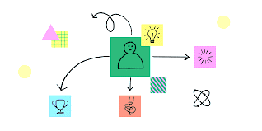
Practical Use Cases for Students
Get COVID-19 stats from an API
Use a News API to display top headlines
Access currency exchange rates
Automate data fetching in projects

Slide 33

Tips and Best Practices
Always check API documentation
Respect API rate limits
Handle errors gracefully (e.g., try/except)
Secure your API keys (don’t share!)

Slide 34
THANK YOU
Instructor : Fawad Bahadur

